Slide 1
EVD17I009: RANJAN YADAV EMC considerations and techniques for UAVs
WHY THIS TOPIC TO BE CONSIDERED OR DISCUSSED?
As it is sometimes reported that unmanned aerial vehicles (UAVs) suffer from loss of control and unpredictable performance due to interference.

Slide 2
WHAT IS EMI ?
Electromagnetic interference (EMI) occurs when a source( external systems or subsystems) discharge energy toward devices.
The unwelcome disturbance diminishes or prevents the use of the devices, and it can compromise in-flight stability. In light of the undesirable consequences, EMI testing examines the possible causes and solutions to intervening currents.
SOURCES:
A variety of sources can produce EMI to an UAV, and testing replicates these circumstances.
NATURAL CAUSES | MAN-MADE
Solar flares and radiation | Human-created machinery
Electrical storms | Cellular Networks

Slide 3
WHAT IS EMC TESTING?
EMC deals with managing undesirable energy. It ensures that products avoid interference in electromagnetic environments, and testing measures how well devices react around other devices and elements.
EMC testing engineers, specialized in prospective electromagnetic dangers, execute a series of trials to ensure products can work alongside fundamental electronic tools used in a range of industries.
Purpose of UAVs EMI/EMC Testing:
1. Government Regulations.
2. Data Protection.
3. Communication Conservation.
4. Performance.
5. Safety.

Slide 4
MAJOR CAUSES OF EMC PROBLEM IN UAVs:
Lack of standard materials and procedure specifications regulating the methods of analysis, measurement and ways of providing EMC of UAV.
Use of the devices based on electronics for control of actuators, and implementation of automated control systems and control based on modern element base.
Production of UAV from composite materials (carbon fiber, fiberglass, etc.) leads to complication of the problem of predicting and providing intra-system EMC.
The UAV may accept a small payload, such as a camera that can be installed by an unqualified user, Some payloads may draw power from the UAVs main (only) battery, Some payloads may incorporate radio transmitters hence may create problems related to EMC.

Slide 5
INTER-SYSTEM EMS UAVs TESTING TECHNIQUES:
The UAV quality is severely restricted by the EMC at the system level.
UAVs are different from manned planes in many ways, so that the EMC test experiences of manned planes cannot be entirely copied.
Generally (MIL-STD-464) of the USA is considered as reference.
GJB1389-92( Chinese standard ) only brings forward some demands for the systems EMC but does not mention all the testing items and methods. Therefore, there is no ready-made method of systems EMC test in UAV field.

Slide 6
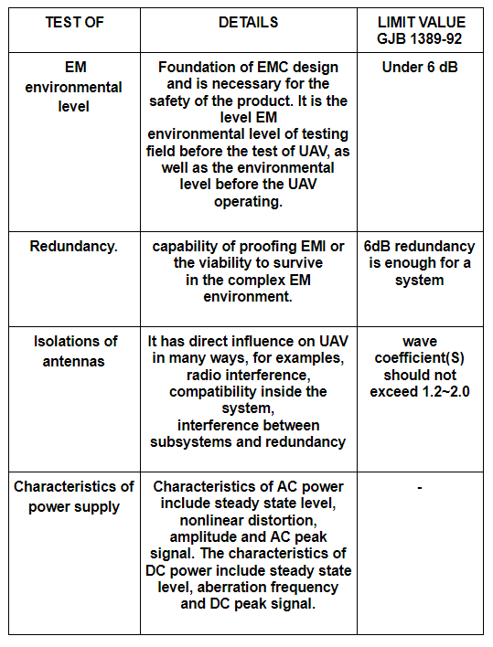
REQUIREMENTS OF TESTING ITEMS:
REQUIREMENTS OF TESTING ITEMS:

Slide 7
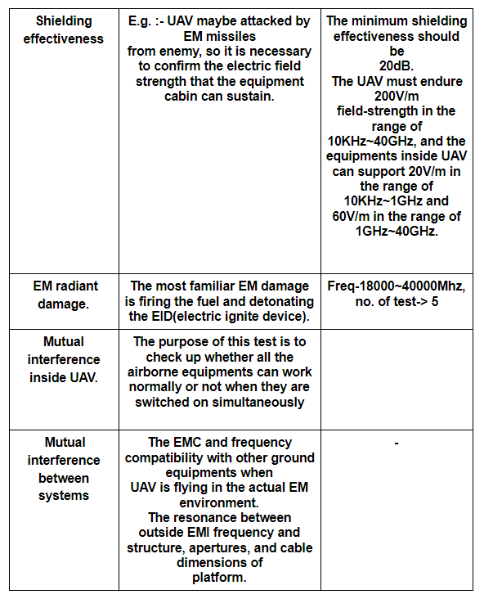
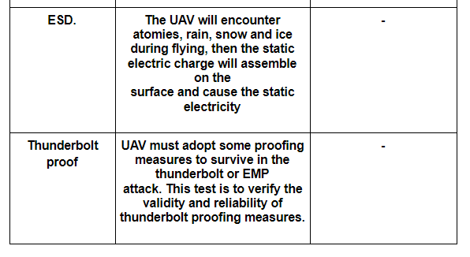

Slide 8
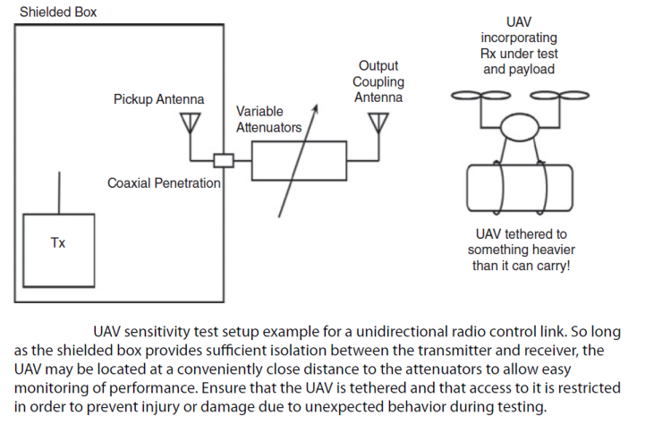
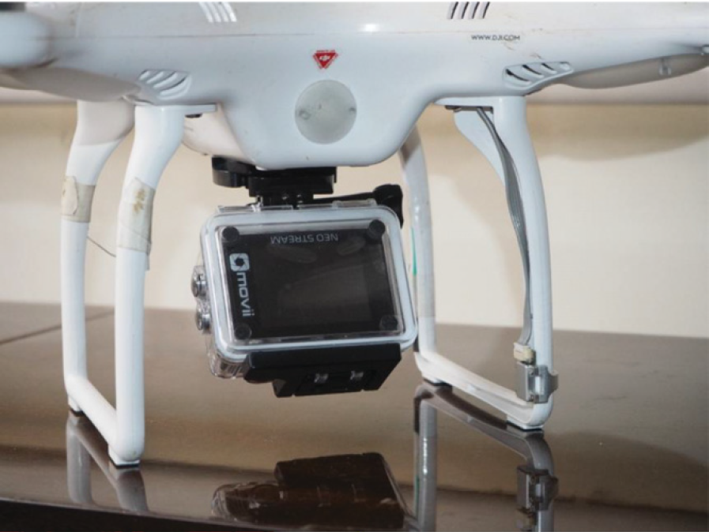
Procedure:
REFERENCE : EMC Considerations for Unmanned Aerial Vehicles
Paul Kay

Slide 9
INTRASYSTEM EMC UAV TESTING TECHNIQUES:
Standards like GJB151A and GJB152A aim at the EMC at the subsystem level ( Chinese Standards).
Step 1. Definition of the main sources of electromagnetic disturbances and mechanisms of their influence on receptors of the UAV avionics.
(Identification of Electromagnetic effects of radio transmitters, Interference, Cross-talk, Conducted electromagnetic disturbance , etc.).
Step 2. Development of techniques for forecasting EMC of the UAV avionics.
( Electromagnetic simulation , Mesh techniques , finite element method, finite difference method in the time and frequency domain ,etc. )
Step 3. Assessment of the results and taking into account the cumulative effects.
(Simultaneous impact of transmitters, emission from coupling path, electromagnetic effects by parasitic capacitance and inductance in a bundle of coupling path and power supply interfaces.)
Step 4. Development of techniques to ensure EMC of UAV avionics.
( Reducing the interrelationship of the source and interference receptor through radiation (shielding, equipment layout, zoning, and grouping etc.))
Step 5. Inspection of ensuring the EMC of UAV avionics. This stage involves the assessment of the efficiency of the technical solutions and trends to ensure the intra-system EMC.

Slide 10
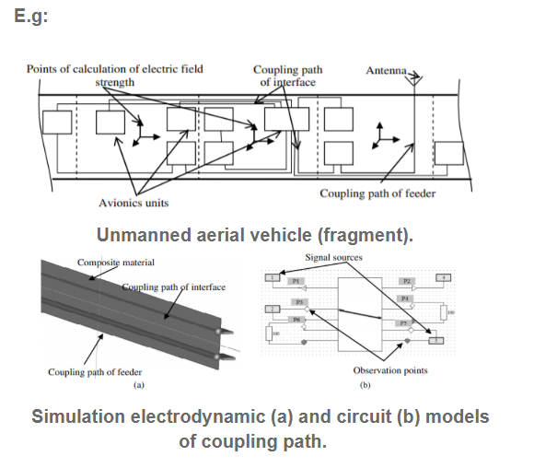
CONCLUSION:
EMI/EMC testing currently is forging ahead in the diligent evaluation of electronics. Professionals are discovering more ways to safeguard aircraft and deliver safe components. The future of electromagnetic trials include faster processing concerns, automation, push for pre-compliance and shortened design cycles.
Trends of EMI/EMC Testing
1. Wireless Communication
2. Intelligent Machines and IoT
3. Simulation
4. Strict Limits
REFERENCE : EMC Considerations for Unmanned Aerial Vehicles
Paul Kay

Slide 11
REFERENCES:
1. EMC Considerations for Unmanned Aerial Vehicles
Paul Kay- Handbook of Aerospace Electromagnetic Compatibility.
2. A Novel Method of EMC Test at The System Level of UAV
Journal by LI BO, Huang Daqing, Nia Riuruic
College of IST, Nanjing University of Aeronautics and Astronautics, Nanjing, China, 210016;
UAV Research Department, Nanjing University of Aeronautics and Astronautics, Nanjing,
China, 210016; Department of Research, Nanjing College of Information
Technology, Nanjing, China,210046
3. Methodology to Ensure the Intrasystem Electromagnetic
Compatibility of UAV Avionics
R. R. Gainutdinov* and S. F. Chermoshentsev
Tupolev Kazan National Research Technical University, ul. Karla Marksa 10, Kazan, 420111 Tatarstan, Russia
4. SMALL UNMANNED AIRCRAFT ELECTROMAGNETIC INTERFERENCE
(EMI) INITIAL ASSESSMENT
Jaewoo Jung, Corey Ippolito, Christopher Rogers, NASA Ames Research Center, Moffett Field, CA
Robert Kerczewski, Alan Downey, NASA Glenn Research Center, Cleveland, OH
Konstantin Matheou, Zin Technologies, Inc., Brook Park, OH

Slide 12
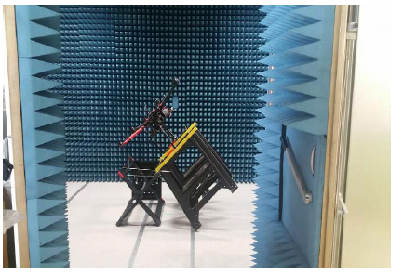
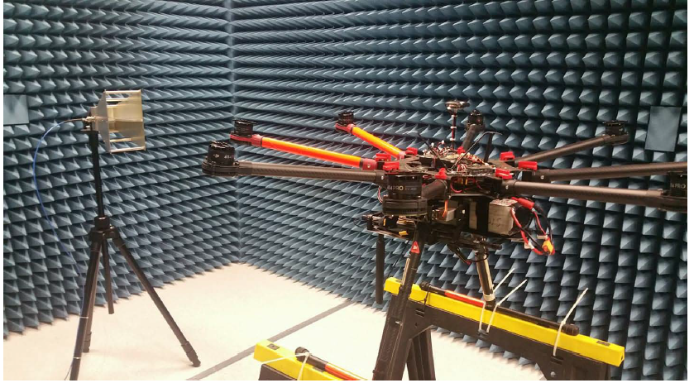
THANK YOU!!
REFERENCE- 4

